Slide 1
displaying & automatically analysing images
https://github.com/FilLieb/NBCimageAnalysis

Slide 2
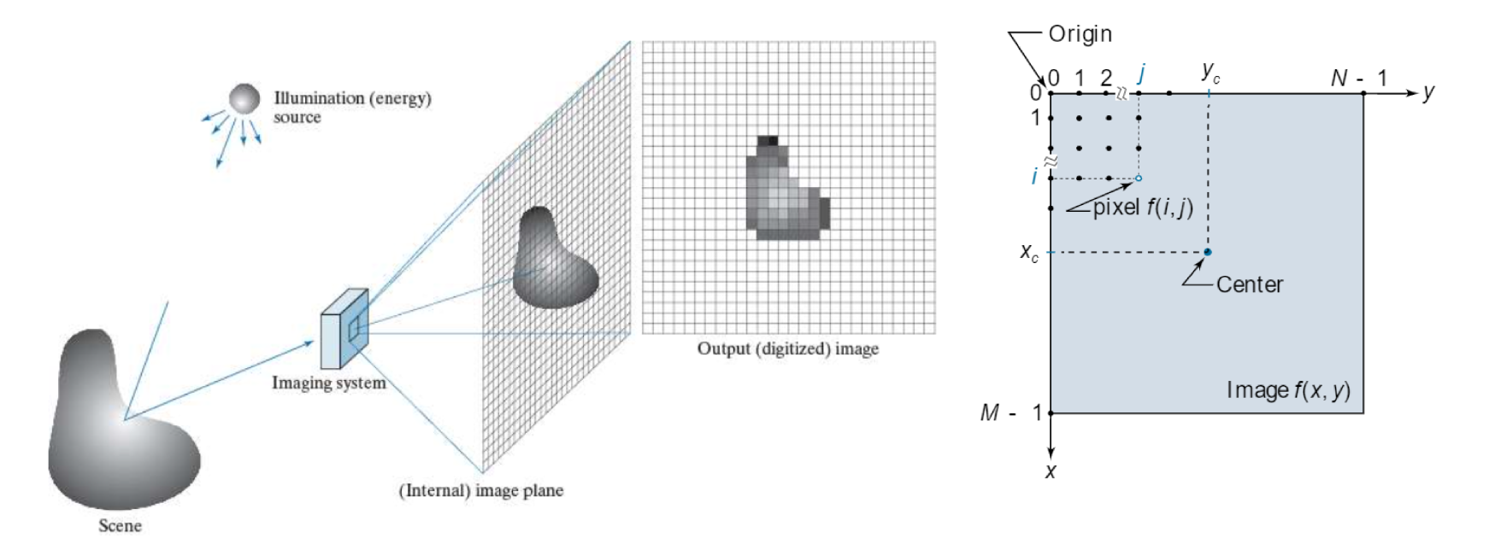
Gonzales & Woods, 2018

Slide 3
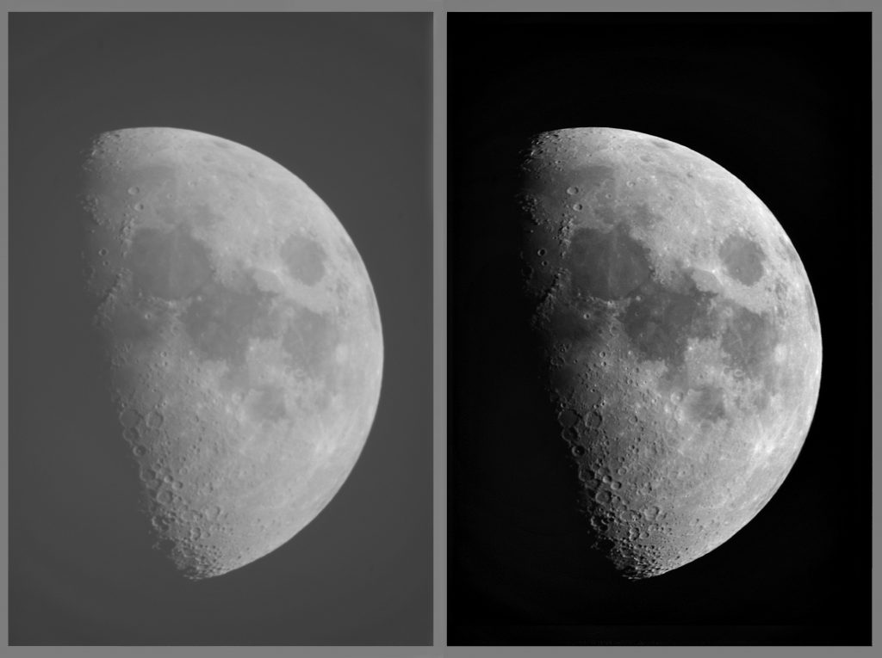
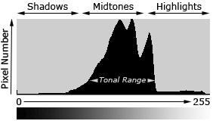
pixel image (gray scale)
8-bit vs. 16-bit
2⁸ = 256 → values: 0-255
2¹⁶ = 65,536 → values: 0-65,535

Slide 4
contrast

Slide 5
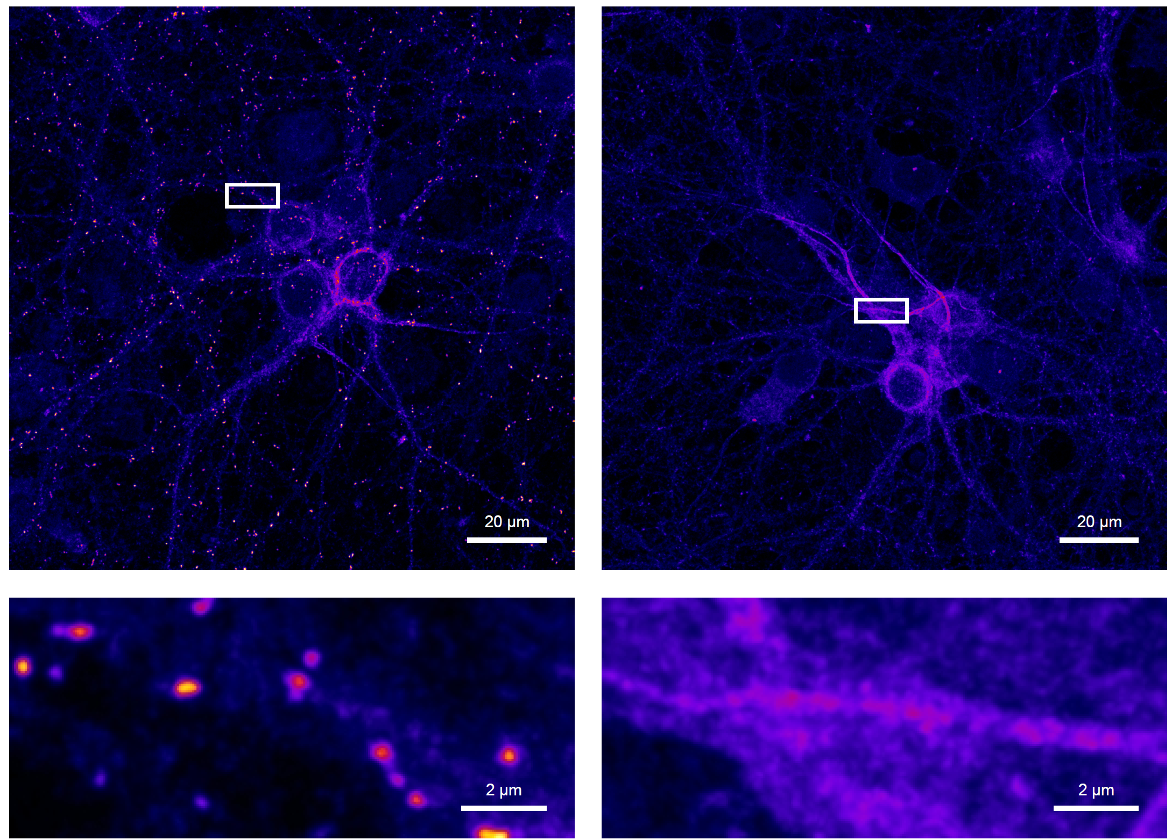
wt
variant
mScarlet-gephyrin

Slide 6

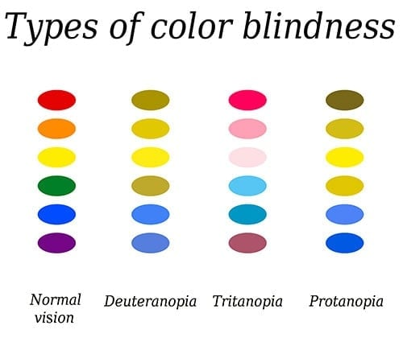
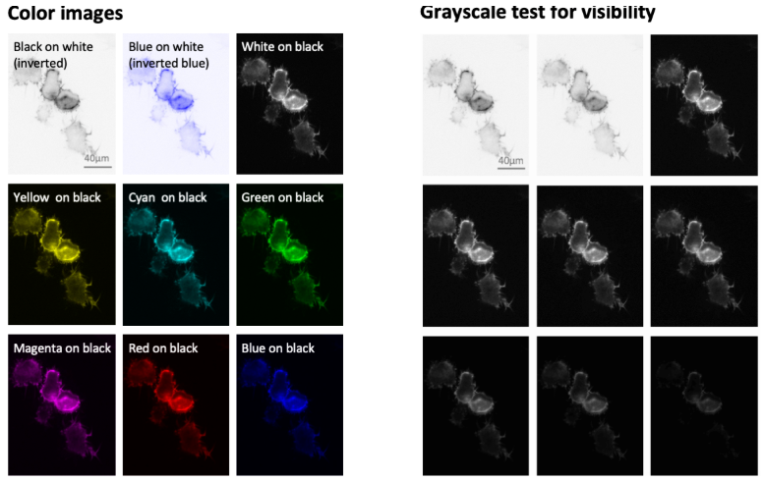
Recap:
github.com/FilLieb/NBCimageAnalysis
Deuteranomaly
(green-weak)
(blue-yellow)
rare
Protanomaly
(red-weak)
Helena Jambor

Slide 7

https://imagej.net/software/fiji/downloads

Slide 8
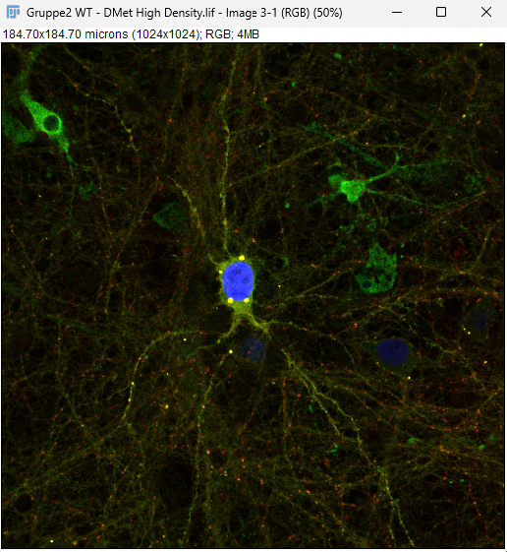
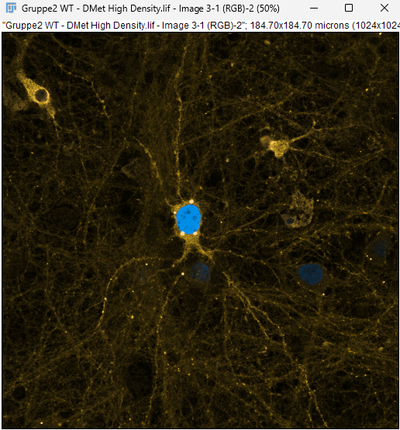
Image -> Duplicate (Ctrl + Shift +D)
Image -> Color -> Stack to RGB
Image -> Color -> Simulate Color Blindness (no red)
Recommended 4-Color Combinations
Magenta / Yellow / Green / Blue or Magenta / Yellow / Cyan / Blue.
…little script (Macro)

Slide 9
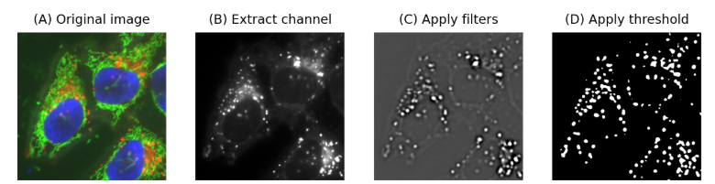
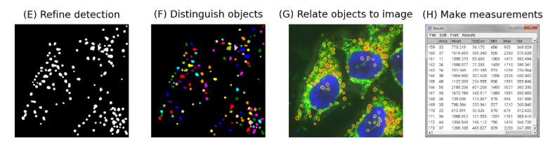
auutomated image analysis
image segmentation
2) quantitative analysis
Pete Bankhead

Slide 10
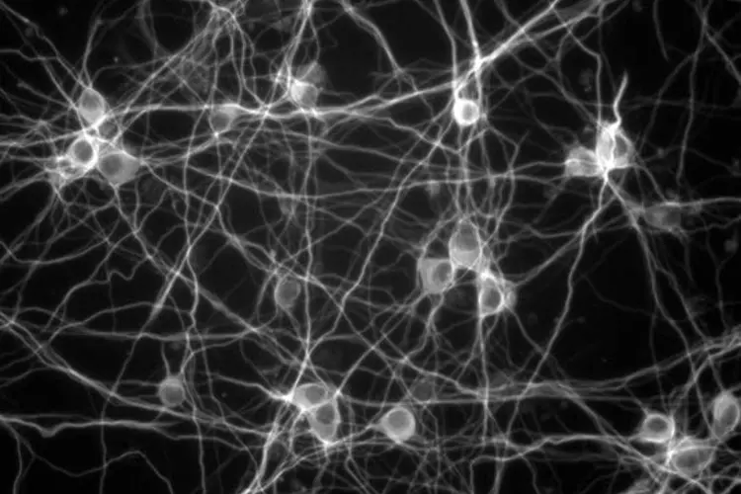

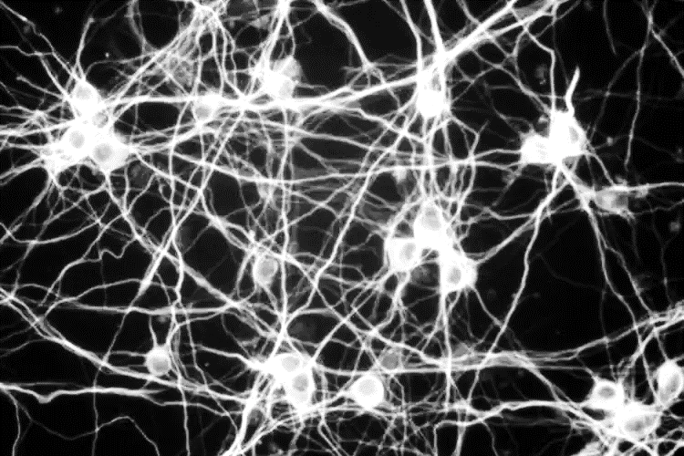
1) segmentation: make a binary image

Slide 11
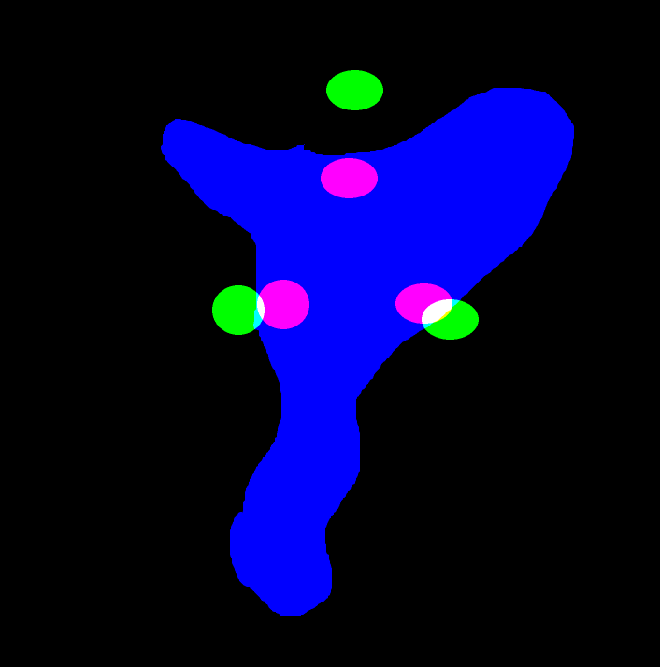
2) quantitative analysis
#/µm²
% vGAT
cluster size [µm²]

Slide 12
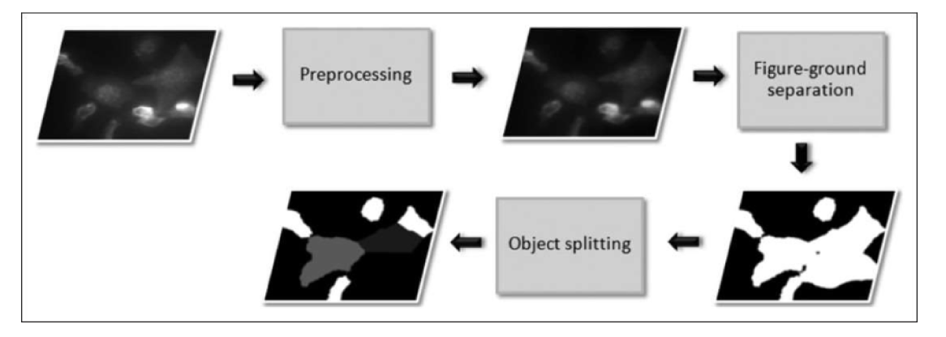
1) segmentation: preprocessing
Peter Zentis, CECAD Imaging Workshop

Slide 13
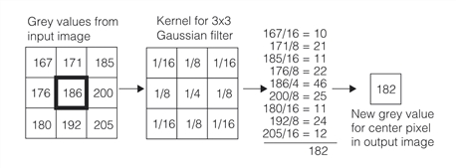
filters, e.g. gaussian

Slide 14
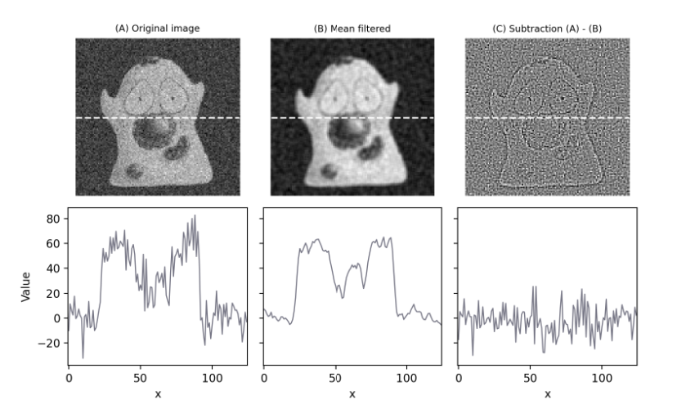
filters → results
Pete Bankhead

Slide 15
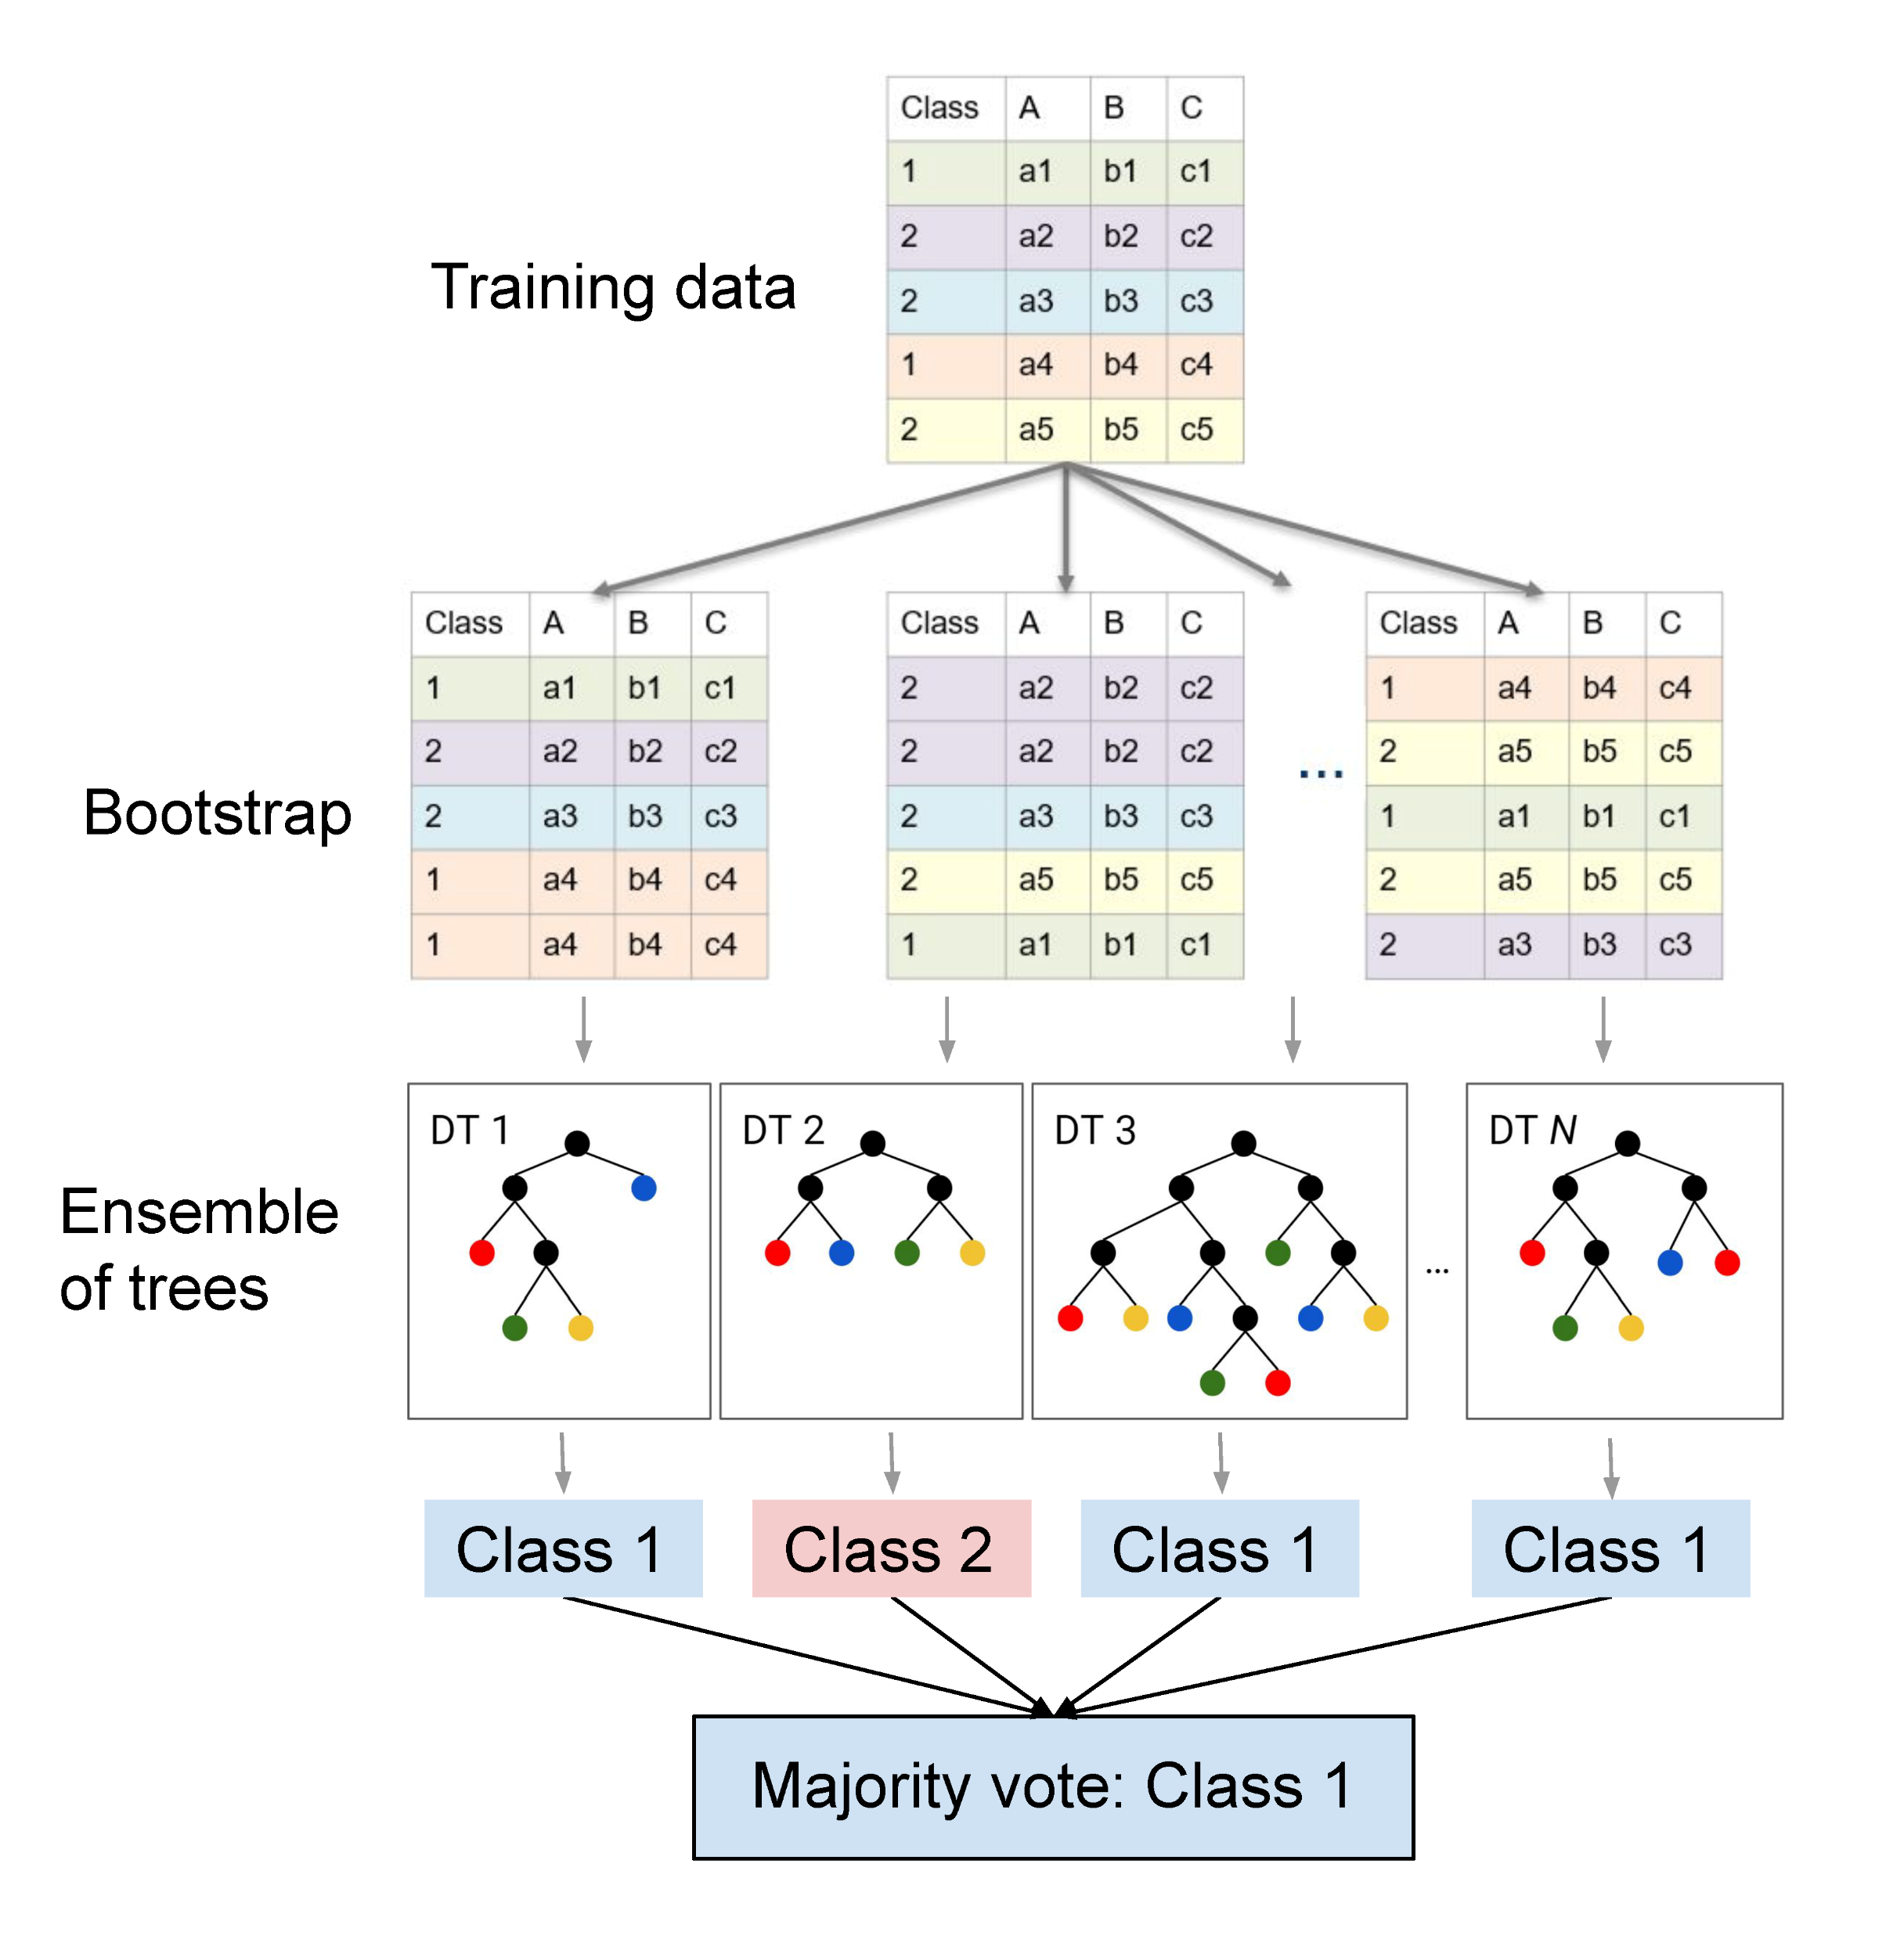
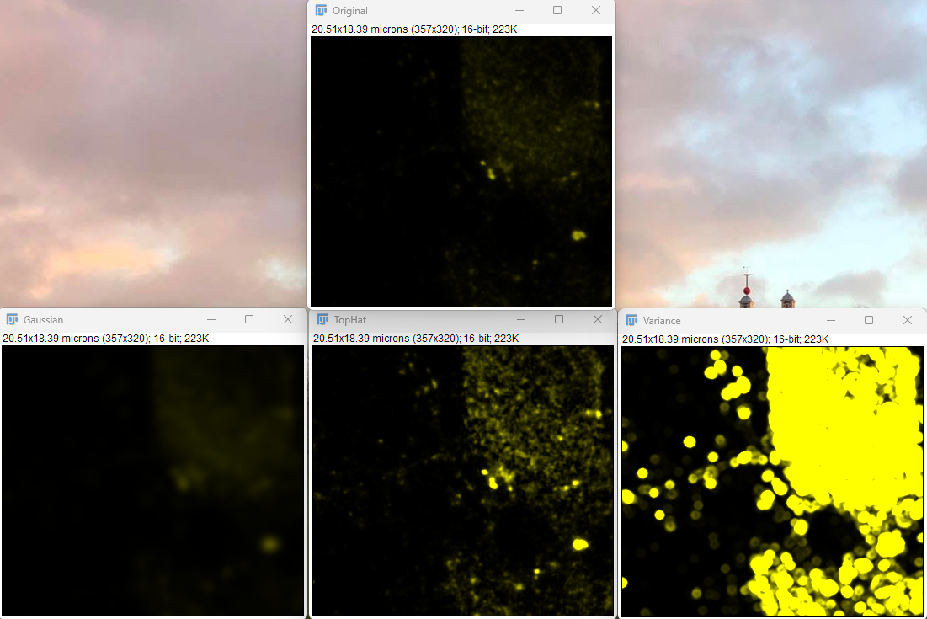
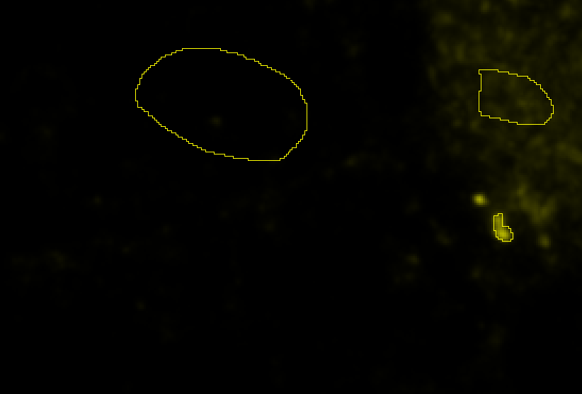
automated analysis (Random Forest)
“new pixel”
background
training
Copyright © 2025 Humboldt-Universität zu Berlin. Department of Geography.
cluster

Slide 16
decision trees
https://www.youtube.com/watch?v=_L39rN6gz7Y&t=40s

Slide 17

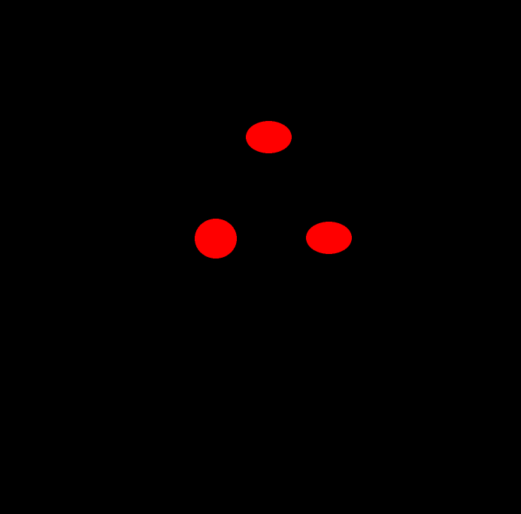
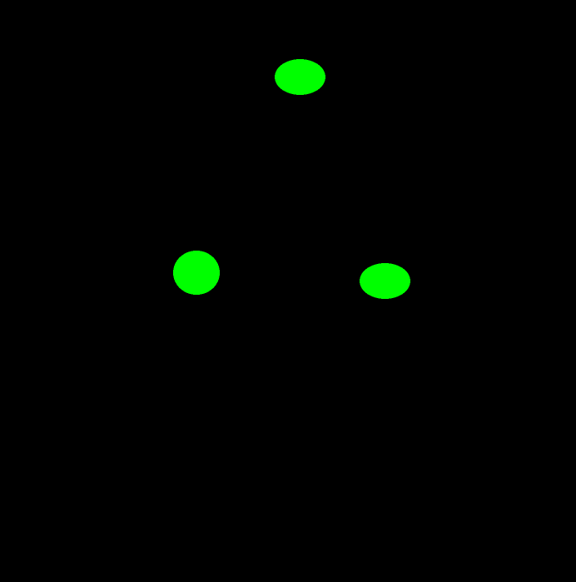
functions
do something
else
split channels
do something
do something
else

Slide 18
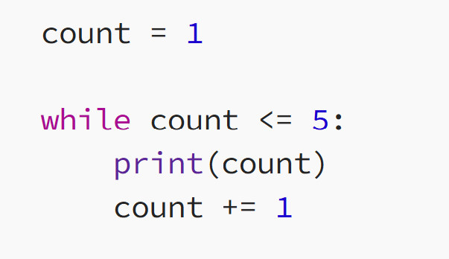
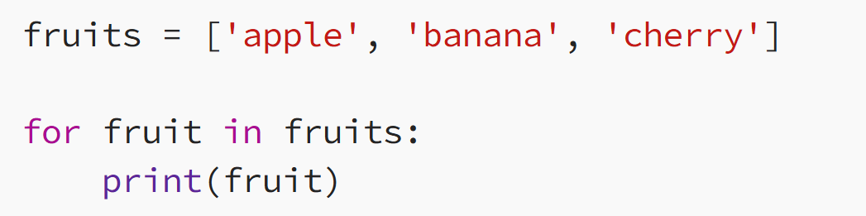
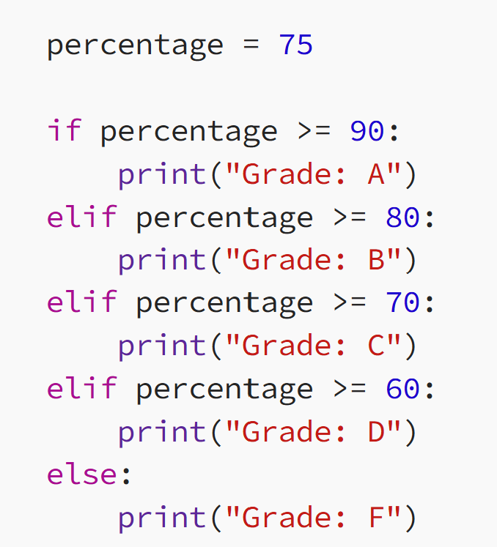
conditional loops
conditional if- then else- statements

